Slide 1
Alfie Kohn
Allison Greene
Courtney Laux
Missy Meyer

Slide 2
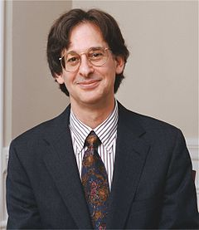
“We want children to continue reading and thinking after school has ended, yet we focus their attention on grades, which have been shown to reduce interest in learning. We want them to be critical thinkers, yet we feed them predigested facts and discrete skills – partly because of various constituencies to pump up standardized test scores” (Kohn 2001, p. 61).

Slide 3
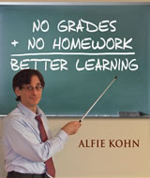
Theory
No grades
No homework
Students learn according to their interests
Treatment of the students
Community

Slide 4
Kohn’s Method Being Applied
http://www.youtube.com/watch?v=G59KY7ek8Rk

Slide 5
Community
Show respect for students
Help students connect with each other
Use classroom meetings
Provide classwide and schoolwide activities
Reflect on academic instruction

Slide 6
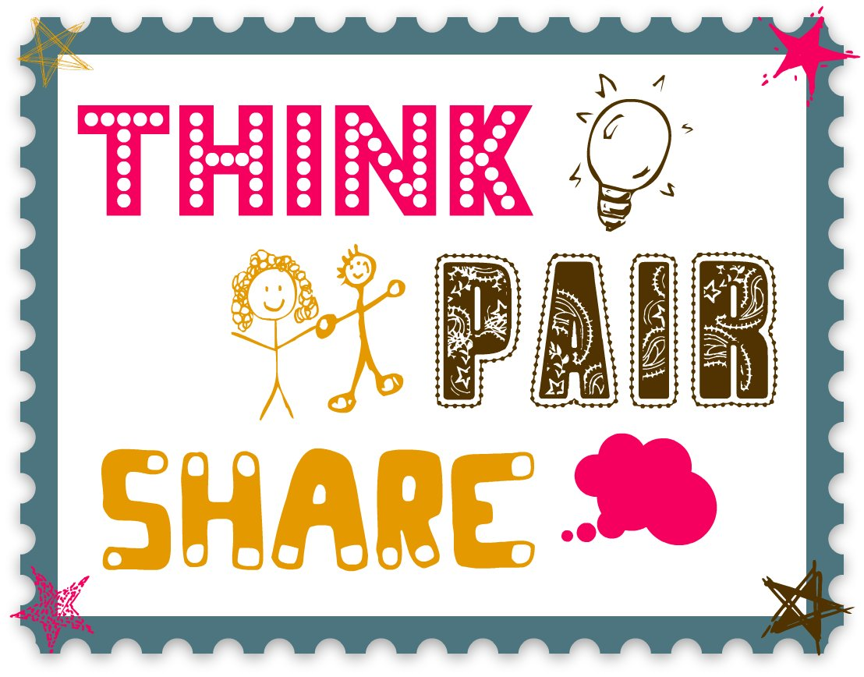
Think – Pair – Share
What do you think about Alfie Kohn’s theories?
Do you think this is realistic approach?

Slide 7
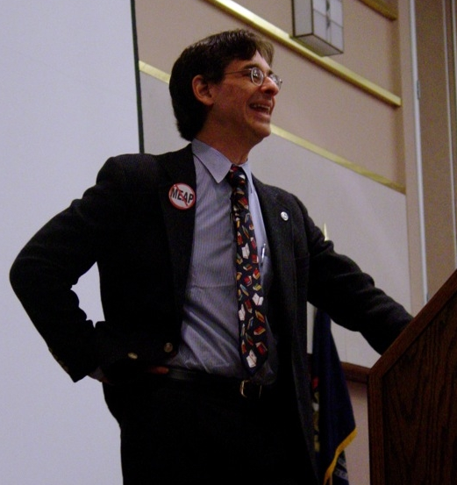
Application for Teachers
Find an equilibrium
Importance of building a community within your classroom
Give students guided choice

